Slide 1
Cs-381 Software Engineering
Course Instructor: Dr. Shazia Arshad
Notes:
Welcome to all of you in this course. I am Dr. Shazia Arshad. I will be your instructor for this course.

Slide 2
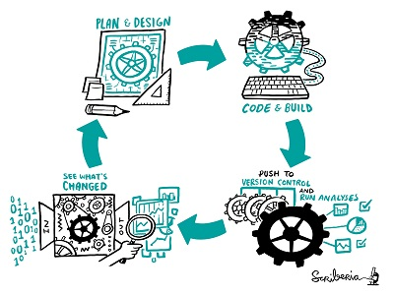
Agile Method
Notes:
As compared to waterfall, agile methodology works in a different way.
Here, a version of the project is released after every iteration. This is called SPRINTS.
It offers flexibility of covering up missing requirements in the next phase (whereas possible).
Agile methods break tasks into smaller iterations, or parts. It does not directly involve long term planning. The project scope and requirements are laid down at the beginning of the development process. Plans regarding the number of iterations, the duration and the scope of each iteration are clearly defined in advance.
Each iteration is considered as a short time "frame" in the Agile process model, which typically lasts from one to four weeks.
The division of the entire project into smaller parts helps to minimize the project risk and to reduce the overall project delivery time requirements. Each iteration involves a team. Team works through a full software development life cycle including planning, requirements analysis, design, coding, and testing before a working product is demonstrated to the client.

Slide 3
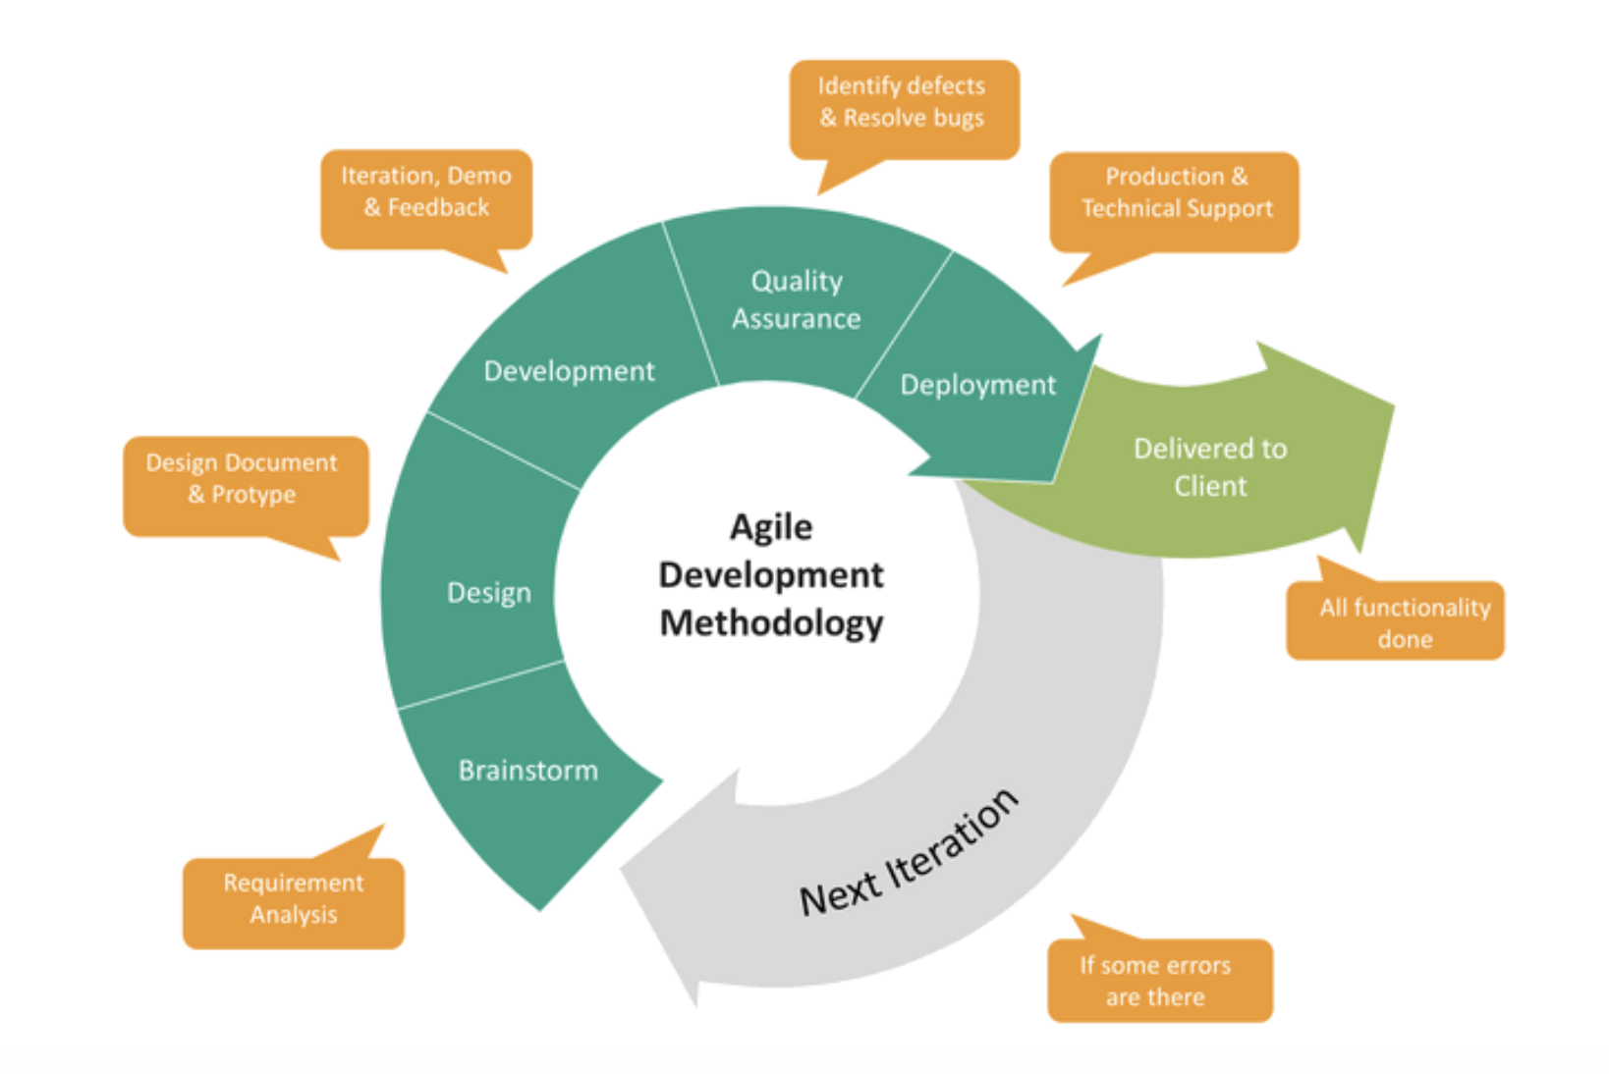
Phases of agile model
Notes:
Phases of Agile Model
Following are the phases in the Agile model are as follows:
Planning and Requirements gathering
Design the requirements
Development and coding
Integration and Testing
Implementation and Deployment
Feedback
In Agile model we are working in sprits and after every sprit which is of 3 to 4 weeks, we deploy our project and always welcome user requirement at every step.

Slide 4
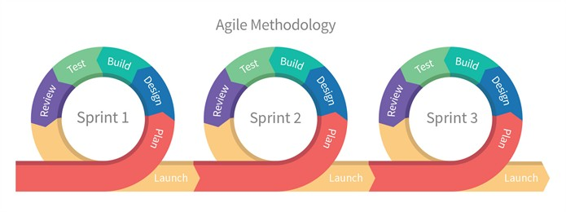
Phases explanation- Requirement Gathering
Notes:
Requirement Gathering:
In this phase, you must define the requirements. You should explain business opportunities and plan the time and effort needed to build the project. Based on this information, you can evaluate technical and economic feasibility.
Before a Product owner can even start designing a project, they need to create the initial documentation that will list the initial requirements. They are:
The end result the project is going to achieve. For example, a text editor.
The features that it will support. For example, different font sizes.
The features that it will not initially support. For example, adding animations to the text or ability to embed video.
A general recommendation is to add basic requirements, adding only the necessary features and ignoring ones that won’t be used often. Developers can work on them later, once the app is deployed and the core features work well.

Slide 5
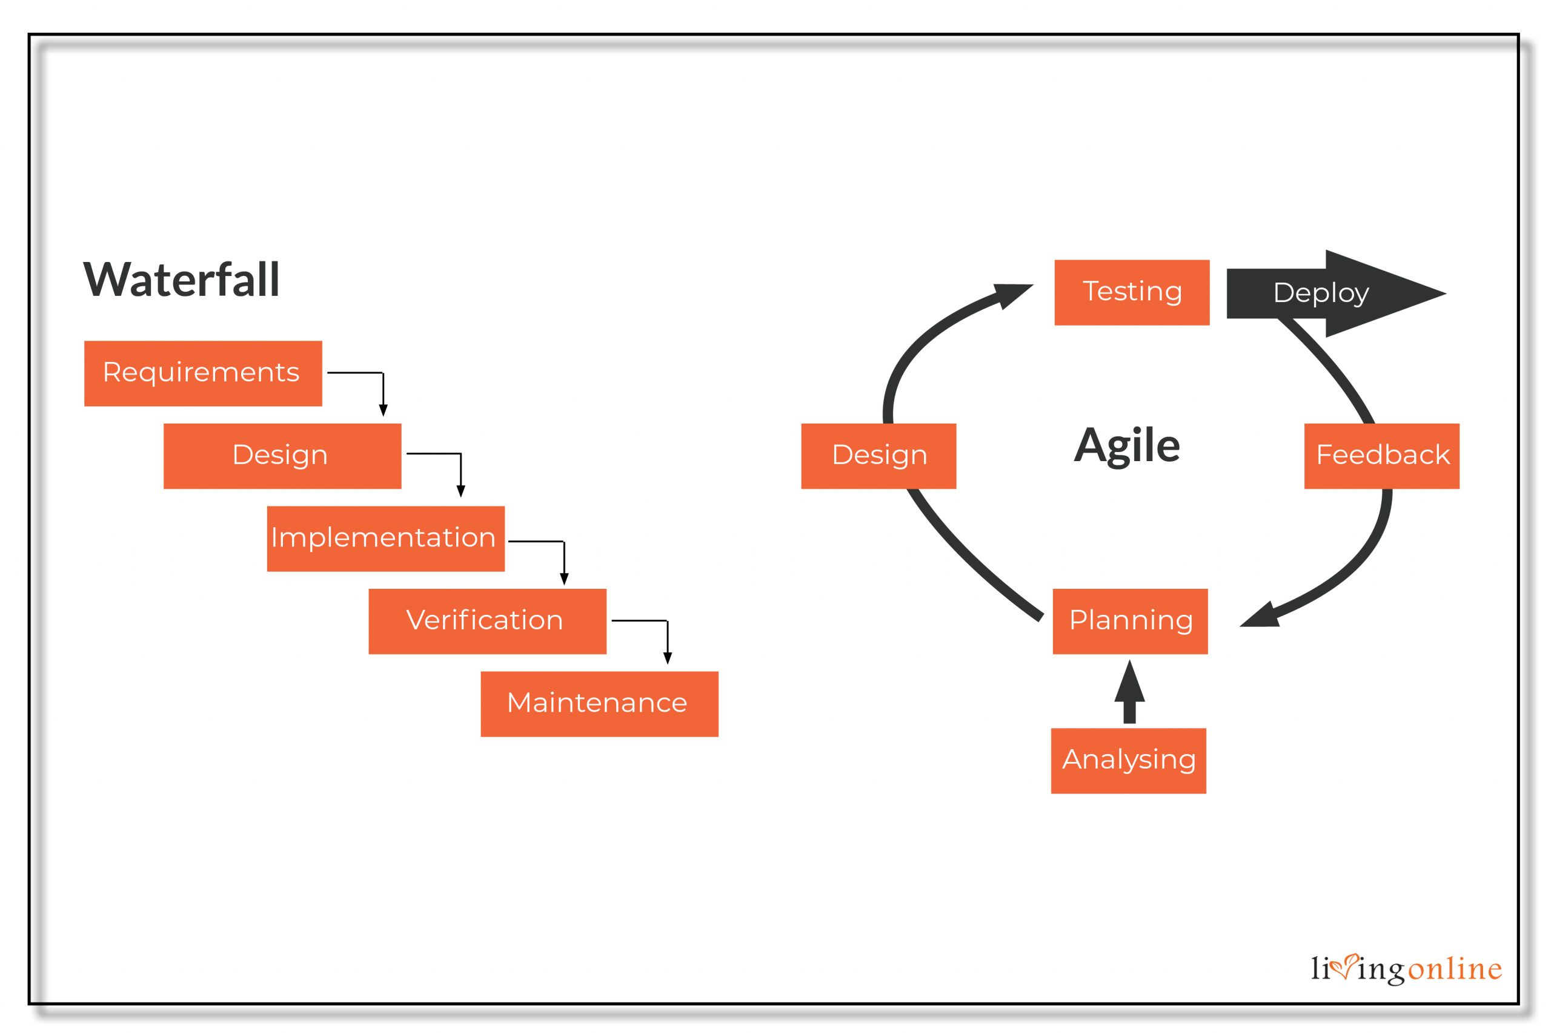
DESIGN AND CODE PHASE
Notes:
Design:
When you have identified the project, then you work with stakeholders to define requirements. You can use the user flow diagram or the high-level UML diagram to show the work of new features and show how it will apply to your existing system.
There are two ways to approach design in the software development — one is the conceptual design and the other is the technical design of the app.
Software Design:
During the first iteration, the product owner assembles their development team and introduces the requirements created during the previous stage. The team then discusses how to tackle these requirements, and proposes the tools needed to achieve the best result. For example, the team defines the programming language, frameworks, and libraries that the project is going to be used.
On further iterations, the developers discuss the feature implementation and the internal structure of the come.
UI/UX Design:
During this SDLC stage, the designers create a rough mock-up of the UI. If the product is consumer-grade, the user interface and user experience are most important. So, it’s generally a good idea to review the possible competitors to see what they are doing right — and especially what they are doing wrong.
Further iterations are spent refining the initial design and/or reworking it to suit the new features.
Development and Coding:
When the team defines the requirements, the work begins. Designers and developers start working on their project, which aims to deploy a working product. The product will undergo various stages of improvement, so it includes simple, minimal functionality at initial stage.
The development phase is about writing code and converting design documentation into the actual software within the software development process. This stage of SDLC is generally the longest as it’s the backbone of the whole process.

Slide 6

INTEGRATE AND TEST
Notes:
Integration and Testing:
In this phase, the Quality Assurance team examines the product's performance and look for the bug.
This stage is spent on making sure that the software is bug-free and compatible with everything else that the developers have written before. The Quality Assurance team conducts a series of tests in order to ensure the code is clean and business goals of the solution are met.
During the further iterations of this SDLC stage, the testing becomes more involved and accounts not only for functionality testing, but also for integration, interoperability, and user acceptance testing, etc.
FUNCTIONAL TESTING is a type of software testing that validates the software system against the functional requirements/specifications. The purpose of Functional tests is to test each function of the software application, by providing appropriate input, verifying the output against the Functional requirements.
INTEGRATION TESTING is a level of software testing where individual units / components are combined and tested as a group. The purpose of this level of testing is to expose faults in the interaction between integrated units.
User Acceptance Testing (UAT) is a type of testing performed by the end user or the client to verify/accept the software system before moving the software application to the production environment. UAT is done in the final phase of testing after functional, integration and system testing is done.
SYSTEM TESTING is a level of testing that validates the complete and fully integrated software product. The purpose of a system test is to evaluate the end-to-end system specifications.

Slide 7
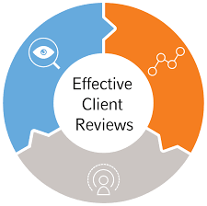
REVIEWS
Notes:
Feedback:
After releasing the product, the last step is feedback. In this, the team receives feedback about the product and works through the feedback.
Once all previous development phases are complete, the product owner gathers the development team once again and reviews the progress made towards completing the requirements. The team introduces their ideas toward resolving the problems that arose during the previous phases and the product owner takes their propositions into consideration.
Afterwards, the Agile software development lifecycle phases start anew — either with a new iteration or by moving toward the next stage.

Slide 8

Agile Methods Example
Notes:
What is Agile Testing?
AGILE TESTING is a testing practice that follows the rules and principles of agile software development. Unlike the Waterfall method, Agile Testing can begin at the start of the project with continuous integration between development and testing. Agile Testing methodology is not sequential (in the sense it's executed only after coding phase) but continuous.
Agile Methods Examples:
Scrum
Crystal
Dynamic Software Development Method (DSDM)
Feature Driven Development (FDD)
Lean Software Development
Extreme Programming (XP)

Slide 9
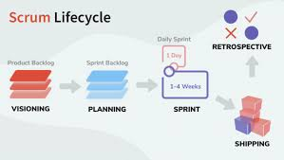
Notes:
Scrum is an agile methodology or framework used primarily for software development projects with the goal of delivering new software capability every 2-4 weeks. It is one of the approaches that influenced the Agile Manifesto, which articulates a set of values and principles to guide decisions on how to develop higher-quality software faster.
SCRUM is an agile development process focused primarily on ways to manage tasks in team-based development conditions.
There are three roles in it, and their responsibilities are:
Scrum Master: The scrum can set up the master team, arrange the meeting and remove obstacles for the process.
Product owner: The product owner makes the product backlog, prioritizes the delay and is responsible for the distribution of functionality on each repetition.
Scrum Team: The team manages its work and organizes the work to complete the sprint or cycle.

Slide 10
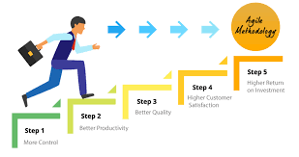
PROS OF AGILE
METHOD
Notes:
Advantage (Pros) of Agile Method:
Frequent Delivery.
Face-to-Face Communication with clients.
Efficient design and fulfils the business requirement.
Anytime changes are acceptable.
It reduces total development time.

Slide 11
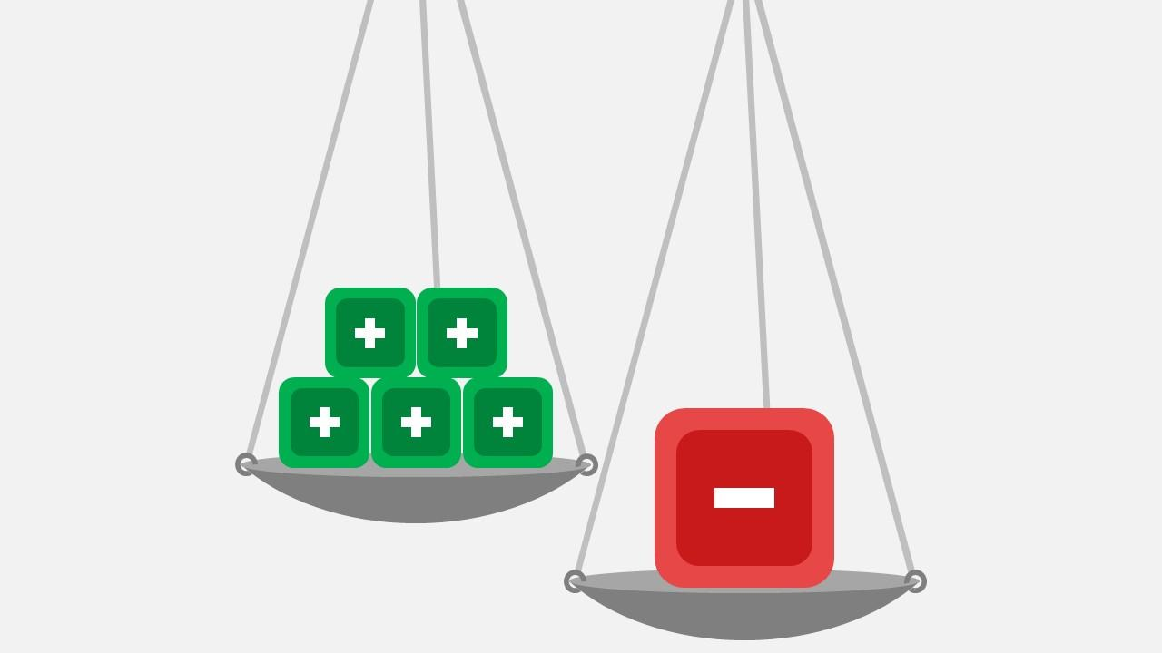
CONS OF AGILE METHOD
Notes:
Disadvantages (Cons) of Agile Model:
Due to the shortage of formal documents, it creates confusion and crucial decisions taken throughout various phases can be misinterpreted at any time by different team members.
Due to the lack of proper documentation, once the project completes and the developers allotted to another project, maintenance of the finished project can become a difficulty.
Less predictability.
More time and commitment.
Greater demands on developers and clients.
Lack of necessary documentation.
Project easily falls off track.

Slide 12
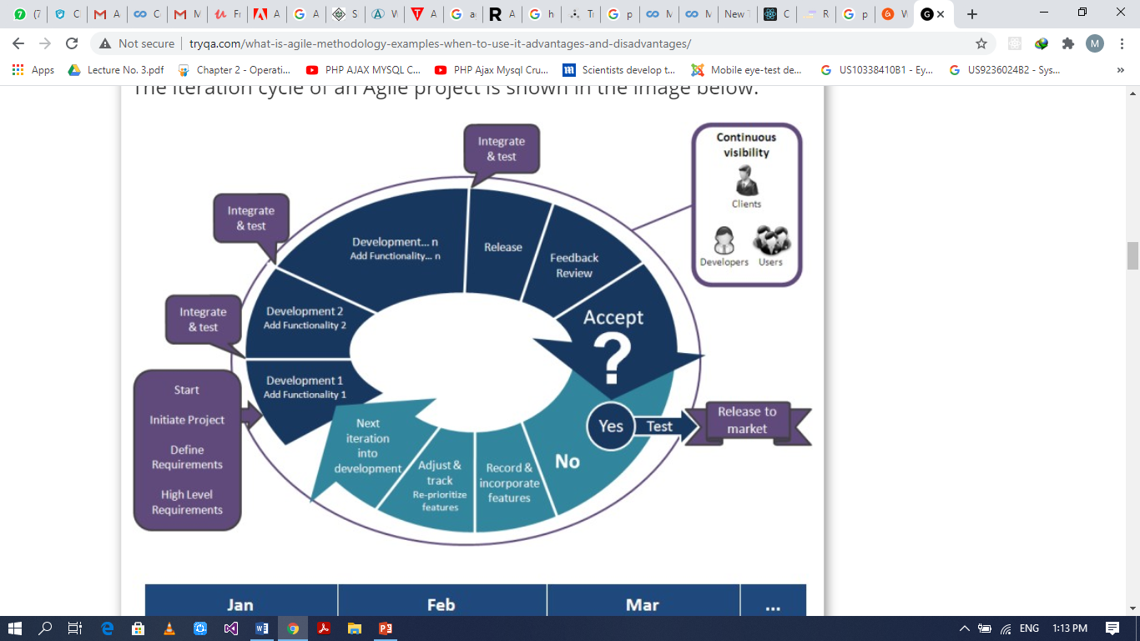
EXAMPLE OF AGILE
Notes:
Example of Agile software development:
Adobe is working on project to come up with a competing product for Microsoft Word, that provides all the features provided by Microsoft Word and any other features requested by the marketing team. The final product needs to be ready in 10 months of time. Let us see how this project is executed in traditional and Agile methodologies.
Solution:
In the Agile methodology, each project is broken up into several ‘Iterations’.
All iterations should be of the same time duration (between 2 to 8 weeks).
At the end of each iteration, a working product should be delivered.
In simple terms, in the Agile approach the project will be broken up into 10 releases (assuming each iteration is set to last 4 weeks).
Rather than spending 1.5 months on requirements gathering, in Agile software development, the team will decide the basic core features that are required in the product and decide which of these features can be developed in the first iteration.
Any remaining features that cannot be delivered in the first iteration will be taken up in the next iteration or subsequent iterations, based on priority.
At the end of the first iterations, the team will deliver a working software with the features that were finalized for that iteration.

Slide 13

CASE STUDY:
Notes:
Case Study
“XYZ”, an emerging group of schools in the market, is planning to develop a “Virtual Classroom System”. In this system, students will register themselves for different courses online. The management wants to see the automation of Lectures, Attendance and Registration to be done as soon as possible due to its immediate need and market competition. The further focus will be on developing online Quizzes and Assignments as well as all issues related to academia of the selected courses. The higher authorities are taking this project as a breakthrough product, which will accelerate their business in the current market remarkably. Risks can arise and must be managed accordingly. If the software is developed successfully, higher management has plans to launch it commercially.
What Software Process Model would you choose and why? State your assumptions clearly, if any, and give logical reasons in support to your answer.

Slide 14

TIME TO THINK
State examples of Agile Model?
Notes:
So, its time to check if you are active or not???
State examples of Agile Model?

